Slide 1











www.imaginecup.com

Slide 2

The Next Web
ASP.NET MVC 3 and WebMatrix
up-close and personal
Brandon Satrom
Developer Evangelist :: Microsoft

Slide 3
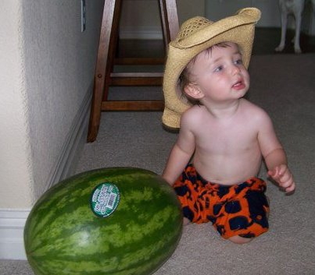
About Me
Technology Evangelist @ Microsoft
Architect & Web Developer
Based in Austin, TX
Husband and Father

Slide 4

A Brief History of Time
Notes:
By “time,” we mean the web according to Microsoft

Slide 5
ASP “Classic”
<% Response.Write(“Before The Bug”)
set conn = CreateObject("ADODB.Connection") conn.open "<connection string>" set rs = conn.execute(“SELECT * FROM sysobjects")
do while not rs.eof obj = rs(0)
rs.movenext loop
Response.Write(“After The Bug”) %>
Notes:
Theme: “there might be something to this web thing”

Slide 6
ASP.NET “Web Forms”
<input type=”hidden” name=”__VIEWSTATE” value=” aHR0cDovL3d3dy5jb2Rlcm9zZXR0YS5jb20vYmFsbHB1enpsZQ==” />
button1.Click += button1_click(sender, eventArgs);
Notes:
THEME: A stateful abstraction over a stateless web

Slide 7
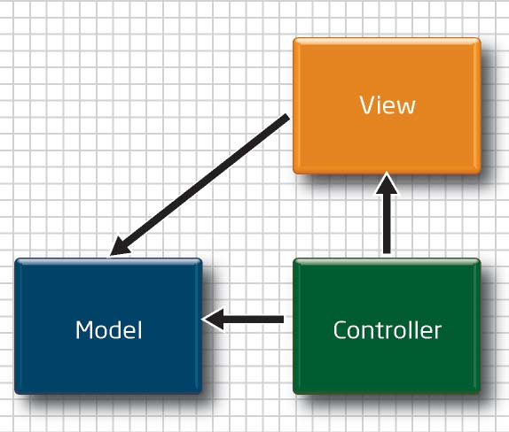
MVC 1 (March 2009)
Notes:
THEME: PLEASE don't leave us for Rails...
Model-View-Controller
Re-Embracing the stateless web
Clean Markup

Slide 8
MVC 2 (March 2010)
Areas
Strongly-typed Helpers
Template Helpers
Validation
Community-Driven
Notes:
THEME: Embracing the Community
Community: jQuery and Insider feedback
What were the high-point features?
Data Annotations
RenderAction
jQuery
Areas
Templated Helpers

Slide 9

What’s Next?

Slide 10

Better experiences for professionals

Slide 11
MVC 3 (Late 2010)
Razor
Dependency Injection
Global Filters
More Validation
SEO Improvements

Slide 12
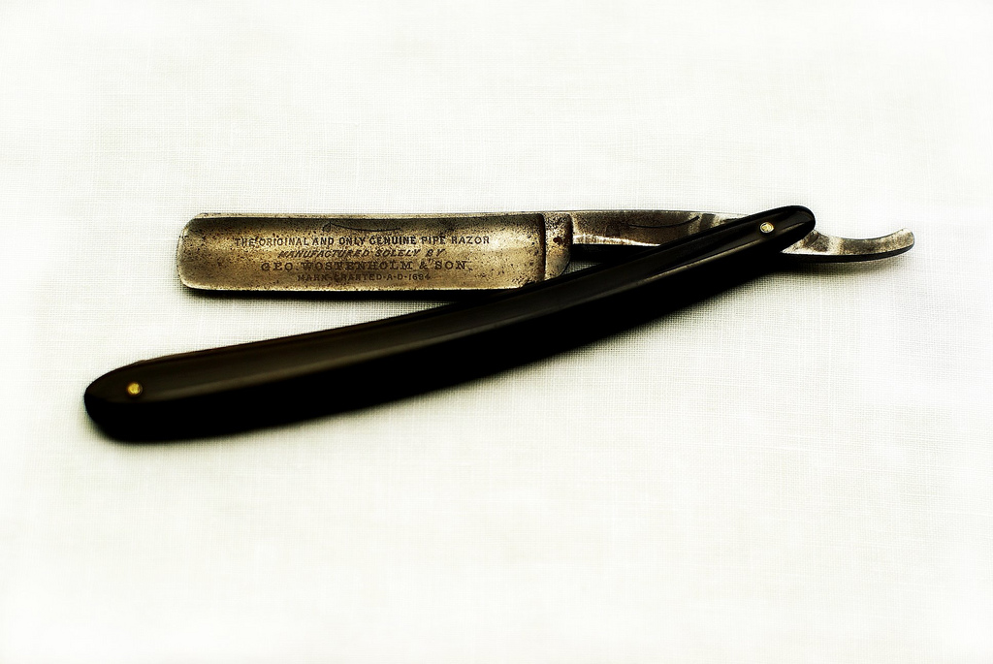
Razor
@ is the new <%= %>
Notes:
Photo Courtesy of: http://www.flickr.com/photos/houseofsims/3889890121/
Story about the Open Space in Nashville

Slide 13
MVC 3 Demo :: Razor, DI, Filters and Validation
RazorLib.net

Slide 14
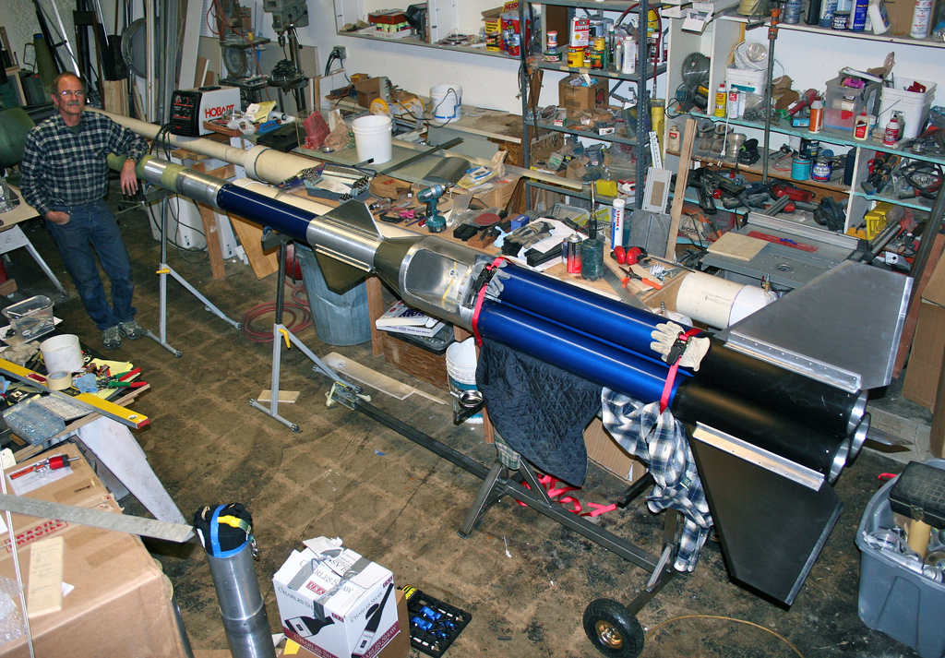
An appealing story for hobbyists
Notes:
Photo courtesy of: http://www.flickr.com/photos/jurvetson/4477406692/

Slide 15
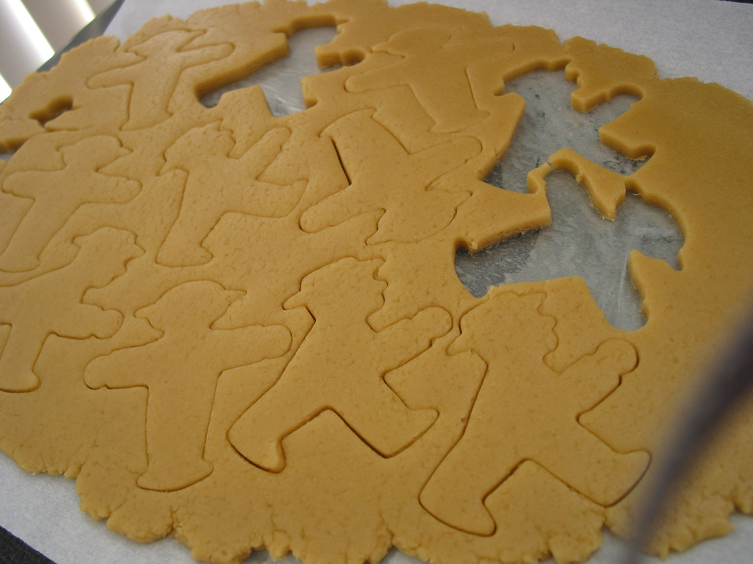
Are all developers the same?
…Should they be?
Notes:
Photo courtesy of: http://www.flickr.com/photos/goosmurf/333861567/
Do they all have the same goals?l
Build the same kind of sites?

Slide 16
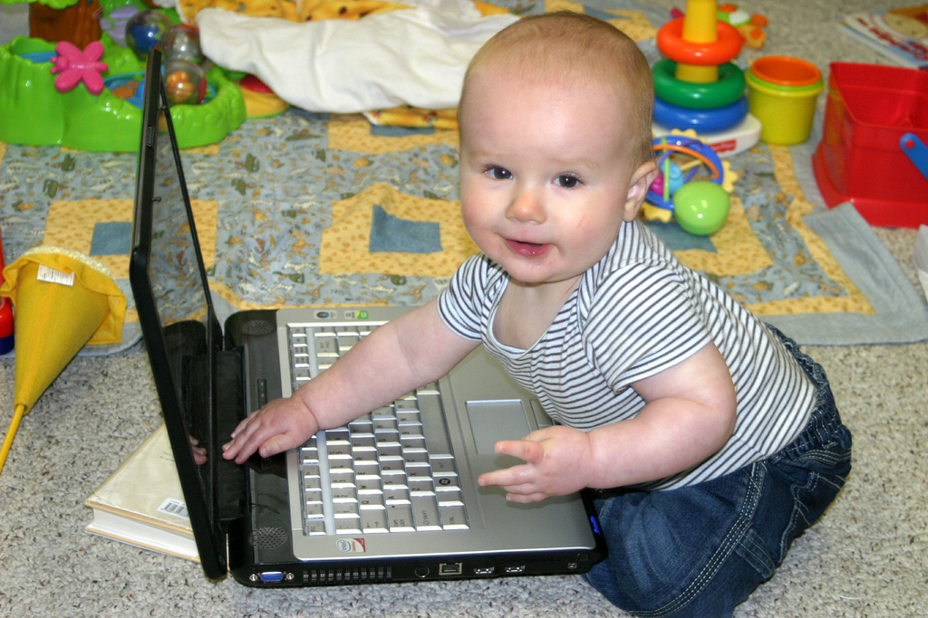
Who Develops for the web?
Notes:
Photo courtesy of: http://www.flickr.com/photos/chimothy27/3487954077/
Everyone!
MySpace Story
Hobbyist developer

Slide 17
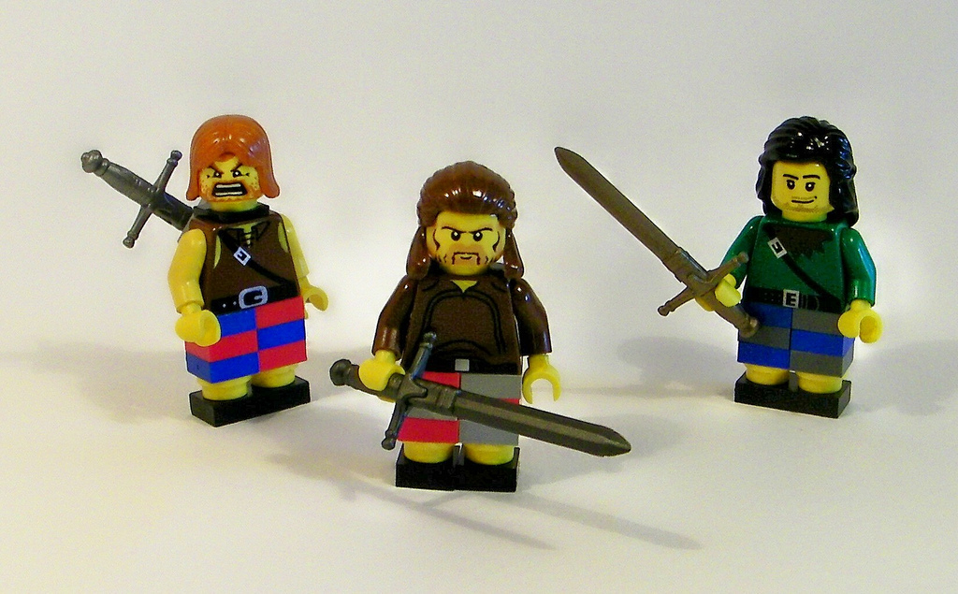
Three Types Of Web Developers (at least)
Notes:
Photo Courtesy of: http://www.flickr.com/photos/38446022@N00/3843482099/

Slide 18

Application Developers
Notes:
Photo Courtesy of: http://www.flickr.com/photos/jonathanbeard/3323613107/in/photostream/
The Jedi

Slide 19

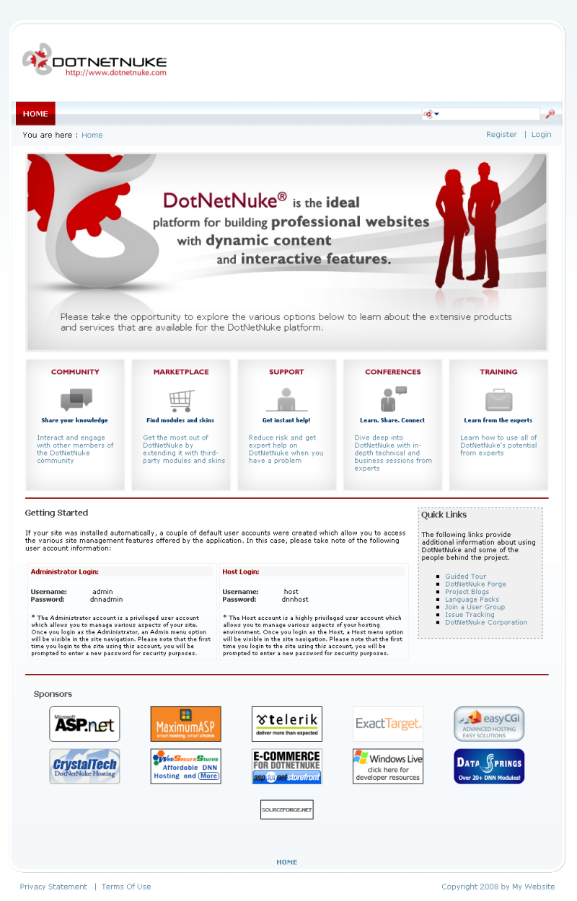
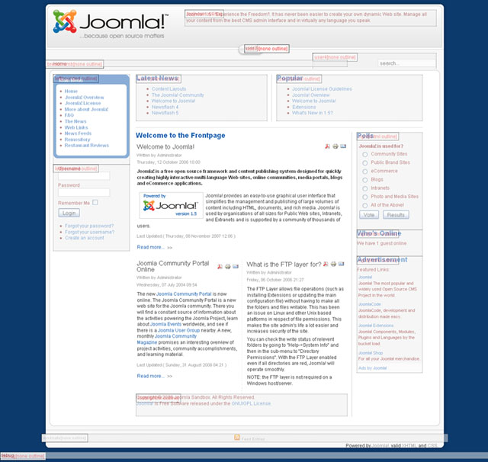
Site Developers
Notes:
Typically, design-heavy companies who turn out sites for others.

Slide 20

Page Developers
Notes:
This is the MySpace Page Modder. The person who uses an app like WordPress to get their own site, downloads and theme and then hacks the php files enough to get the site to their liking

Slide 21
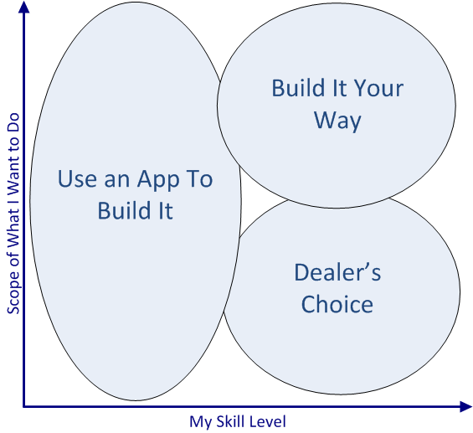
Skills and Goals..

Slide 22
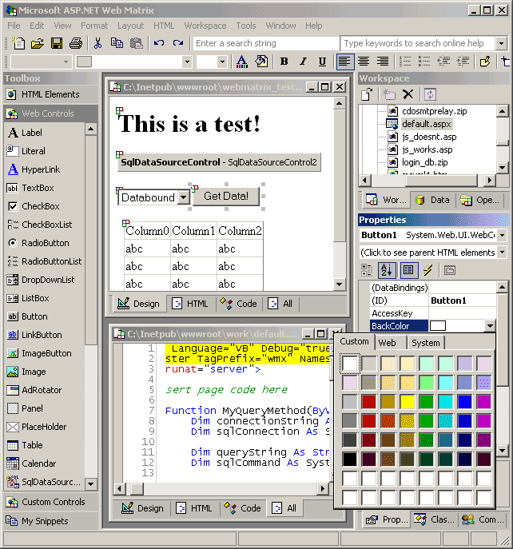
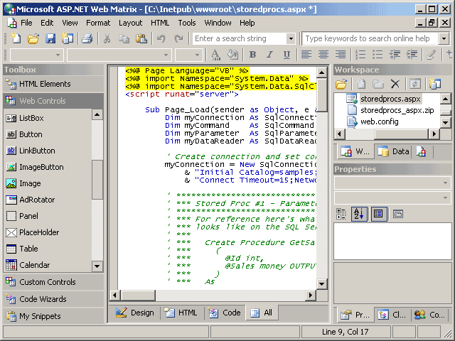
Microsoft WebMatrix
Not that one…

Slide 23

Microsoft WebMatrix

Slide 24
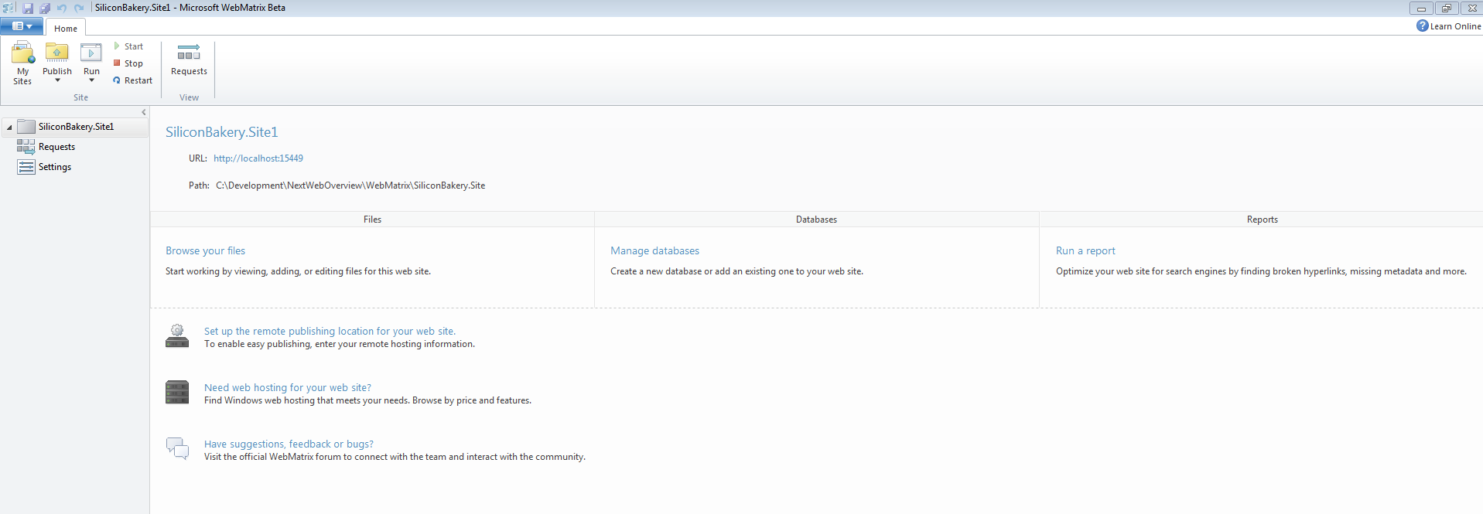
IIS Express

Slide 25
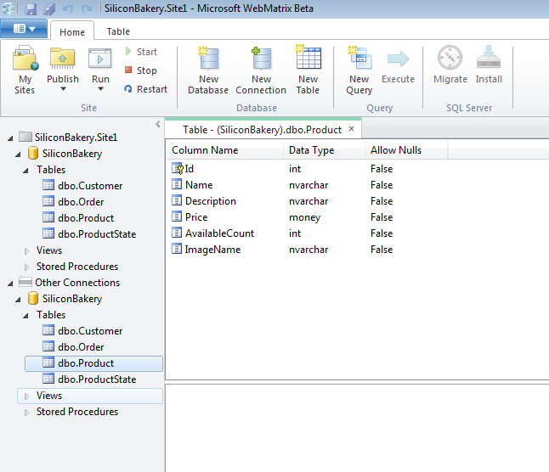
SQL Compact Edition

Slide 26

ASP.NET Web Pages With Razor Syntax
Notes:
Photo Courtesy of: http://www.flickr.com/photos/kwl/4637797463/

Slide 27
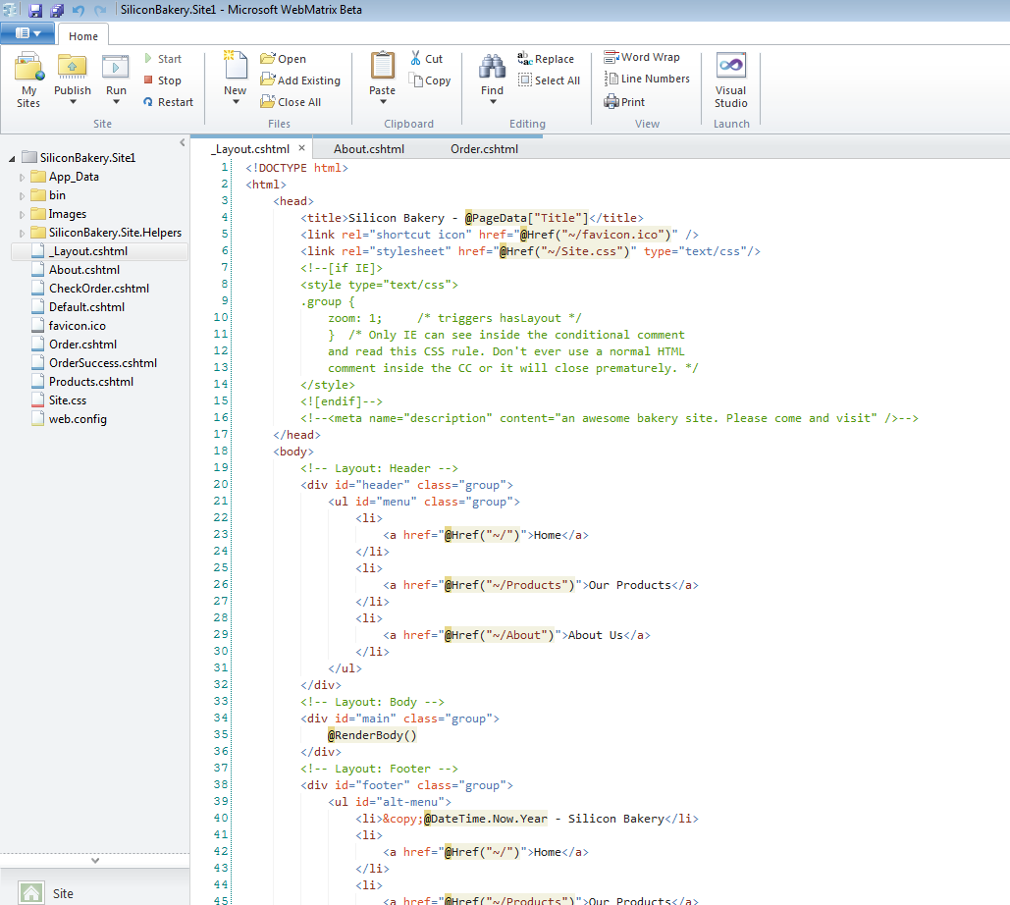
IDE

Slide 28

WebMatrix Demo :: SiliconBakery

Slide 29


Enabling the next step…

Slide 30

Resources
MVC 3 ::
http://bit.ly/mvc3-download
http://bit.ly/mvc3-source
WebMatrix ::
http://bit.ly/WMBeta

Slide 31

Questions?
Email: brsatrom@microsoft.com Twitter: @BrandonSatrom
Blog: www.userinexperience.com

